Slide 1
CAD Tutorial
Day 2

Slide 2
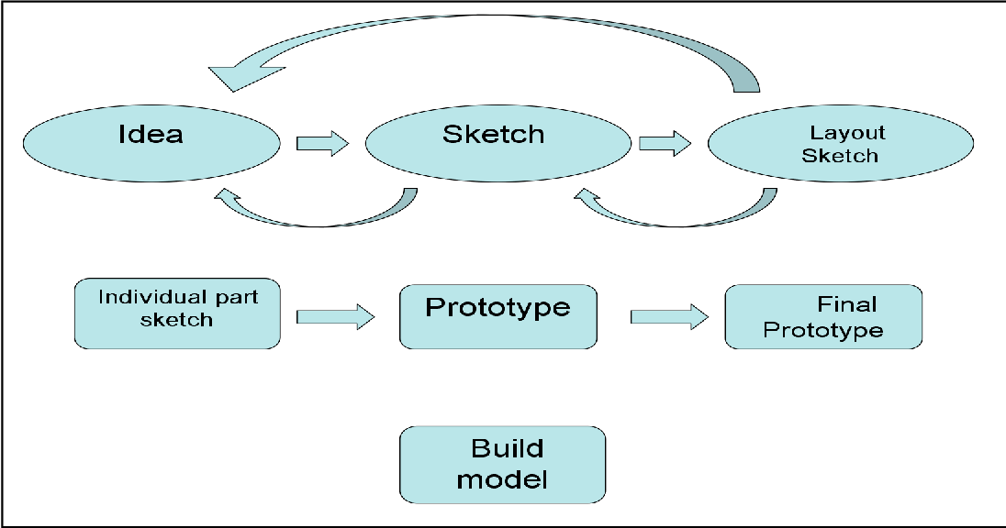
CAD Design Process

Slide 3
3D Printing Basics
Supports
Infill
Comparing 3D printers
Structural strength

